Slide 1
US Food Security and Climate Change: Agriculture Futures
Country authors:
Eugene S. Takle, Iowa State University
Dave Gustafson, Monsanto Company
Roger Beachy, Danforth Plant Science Research Center
Modeling team:
Gerald C. Nelson, Daniel Mason-D’Croz, and Amanda Palazzo, International Food Policy Research Institute
Based on the report: “US Food Security and Climate Change: Agriculture Futures”, Eugene S. Takle, Roger Beachy, David Gustafson, and modeling team Gerald C. Nelson, Daniel Mason-D’Croz, and Amanda Palazzo, International Food Policy Research Institute, 2011

Slide 2
Outline
Introduction
Agriculture, Food Security and US Development
Scenarios for Adaptation
Agriculture and Greenhouse Gas Mitigation
Conclusions
Summary for Policy Makers

Slide 3
Introduction Overview
Projected impact of climate change on USA food security through the year 2050
Overview of USA current food security situation, the underlying natural resources
USA-specific outcomes of a set of scenarios for the future of global food security in the context of climate change based on IMPACT model runs from September 2011.

Slide 4
Introduction Regional Impacts of Climate Change
Higher temperatures reduce yields and encourage weed and pest proliferation
Increased variations in precipitation increase the likelihood of short-run crop failures and long-run production declines.
overall impacts of climate change on agriculture are expected to be negative, threatening global food security.
The impacts are
Direct, on agricultural productivity
Indirect, on availability/prices of food
Indirect, on income from agricultural production

Slide 5
Introduction Regional Impacts of Climate Change
Four Global Climate Models (GCMs), with A1B emissions scenario, are used to simulate climate changes from 2000 to 2050
Substantial differences exist among GCM results despite use of the same widely accepted laws of physics
Differences in how models account for features of the atmosphere and surface smaller than about 200 km (e.g., cloud processes and land-atmosphere interactions) account for differences in temperature and precipitation
Each model’s smaller scale uniquenesses eventually interact with the global flow to create different regional climate features among the models

Slide 6
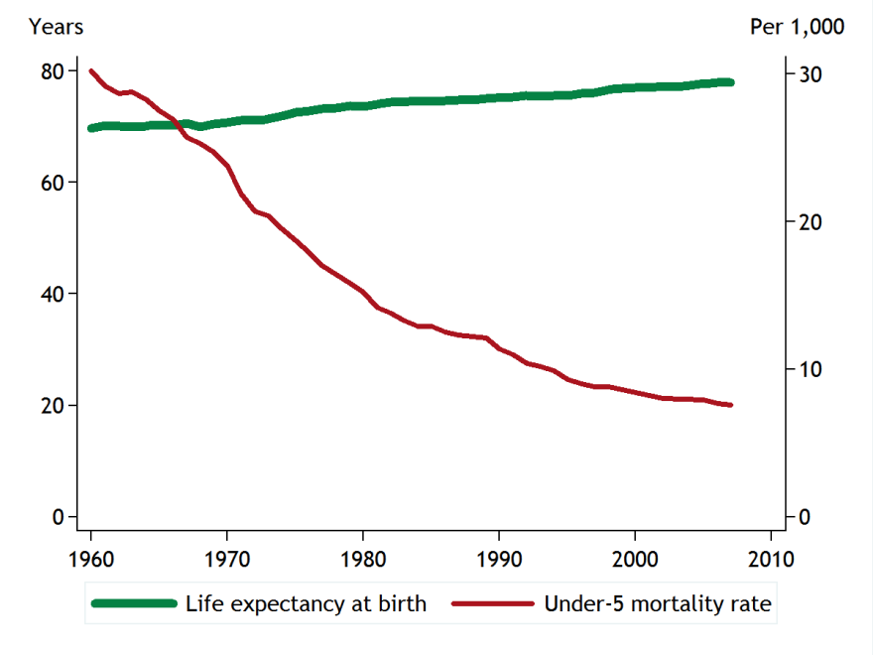
Agriculture, Food Security and US Development Review of Current Situation
Proportion of the population living on less than $2 per day is near zero
Education levels are high
Under-5 malnutrition level is very low
Well-being indicators (life expectancy at birth and under-5 mortality rate) are favorable and have improved in the last 47 years
Life Expectancy
Under-5 Mortality
Source: World Development Indicators (World Bank, 2009)

Slide 7
Agriculture, Food Security and US Development Review of Land Use
Source: GLC2000 (JRC 2000)
A significant fraction of total land area is set aside as wilderness areas, national parks,
habitat and species management areas, etc. to provide important protection for
fragile environmental areas, which may also be important for the tourism industry.

Slide 8
Agriculture, Food Security and US Development Review of Land Use
Source: GLC2000 (JRC 2000)
A significant fraction of total land area is set aside as wilderness areas, national parks,
habitat and species management areas, etc. to provide important protection for
fragile environmental areas, which may also be important for the tourism industry.

Slide 9
Agriculture, Food Security and US Development Review of Agriculture
Data 2006-2008
Area Harvested
Value of Production
Leading Foods
Source: FAOSTAT (FAO 2010)

Slide 10
Agriculture, Food Security and US Development Review of Agriculture
Maize
Irrigated
Yield
Harvest area density
Rain-fed
Yield
Harvest area density
Source: SPAM Dataset (Liangzhi You, Wood, and Wood-Sichra 2009)

Slide 11
Agriculture, Food Security and US Development Review of Agriculture
Maize
Irrigated
Yield
Harvest area density
Rain-fed
Start here
Yield
Harvest area density
Source: SPAM Dataset (Liangzhi You, Wood, and Wood-Sichra 2009)

Slide 12
Agriculture, Food Security and US Development Review of Agriculture
Maize
Irrigated
Yield
Harvest area density
Rain-fed
Start here
Yield
Harvest area density
Source: SPAM Dataset (Liangzhi You, Wood, and Wood-Sichra 2009)

Slide 13
Agriculture, Food Security and US Development Review of Agriculture
Maize
Irrigated
Yield
Harvest area density
Rain-fed
Start here
Yield
Harvest area density
Source: SPAM Dataset (Liangzhi You, Wood, and Wood-Sichra 2009)

Slide 14
Agriculture, Food Security and US Development Review of Agriculture
Maize
Irrigated
Yield
Harvest area density
Rain-fed
Yield
Harvest area density
Source: SPAM Dataset (Liangzhi You, Wood, and Wood-Sichra 2009)

Slide 15
Agriculture, Food Security and US Development Review of Agriculture
Soybeans
Irrigated
Yield
Harvest area density
Rain-fed
Yield
Harvest area density
Harvest area density
Source: SPAM Dataset (Liangzhi You, Wood, and Wood-Sichra 2009)

Slide 16
Scenarios for Adaptation Economic and Demographic Drivers
Three pathways
baseline scenario: “middle of the road”
pessimistic scenario: plausible, but negative
optimistic scenario: improves over baseline.
These three overall scenarios are further qualified by four GCM climate scenarios based on scenarios of GHG emissions

Slide 17
GCM Projected Changes in Climate: 2000-2050
Precipitation
Temperature

Slide 18
GCM Projected Changes in Climate: 2000-2050
Precipitation
CSIRO model gives small change in climate
Temperature

Slide 19
GCM Projected Changes in Climate: 2000-2050
Precipitation
CSIRO model gives small change in climate
MIROC model gives large change in climate
Temperature

Slide 20
Scenarios for Adaptation Biophysical Scenarios
Observed US cotton yields (1930 to present)
Observed US soybean yields (1930 to present)
Observed US maize yields (1930 to present)
Mean annual temperatures for cotton, maize, and soybean US production areas (1930 to present)

Slide 21
Maize Yields in Iowa
1866-2009

Slide 22
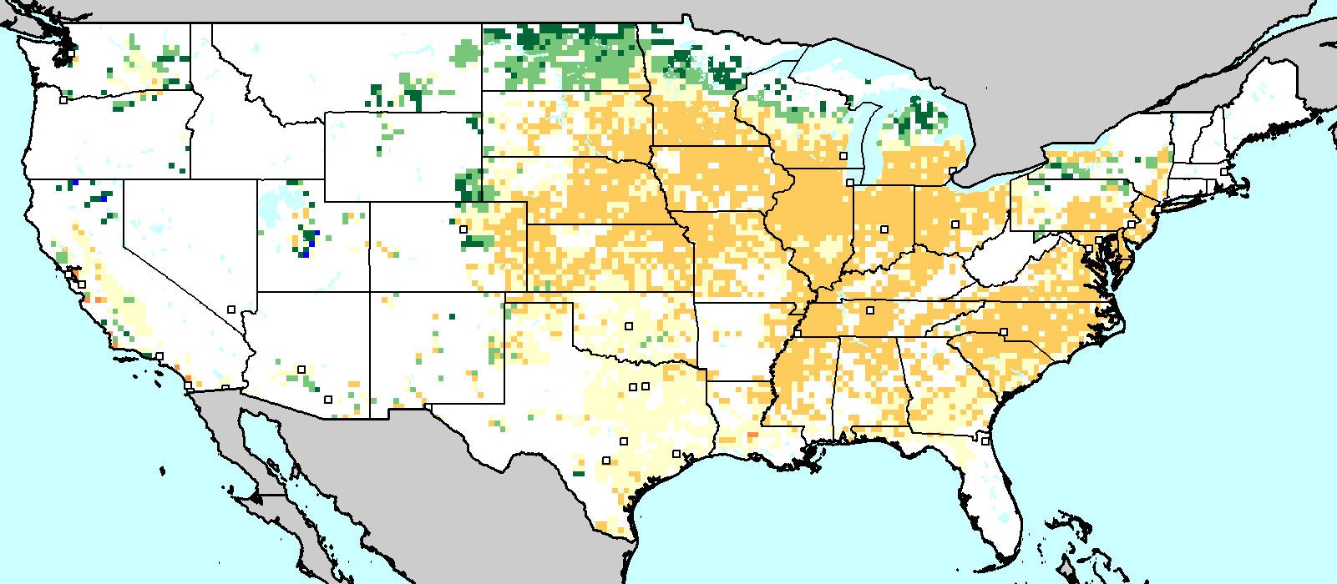
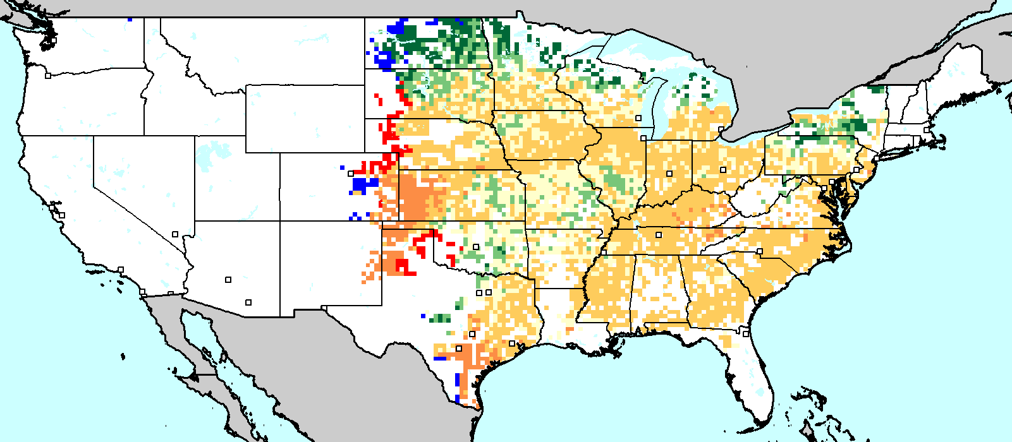
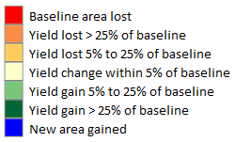
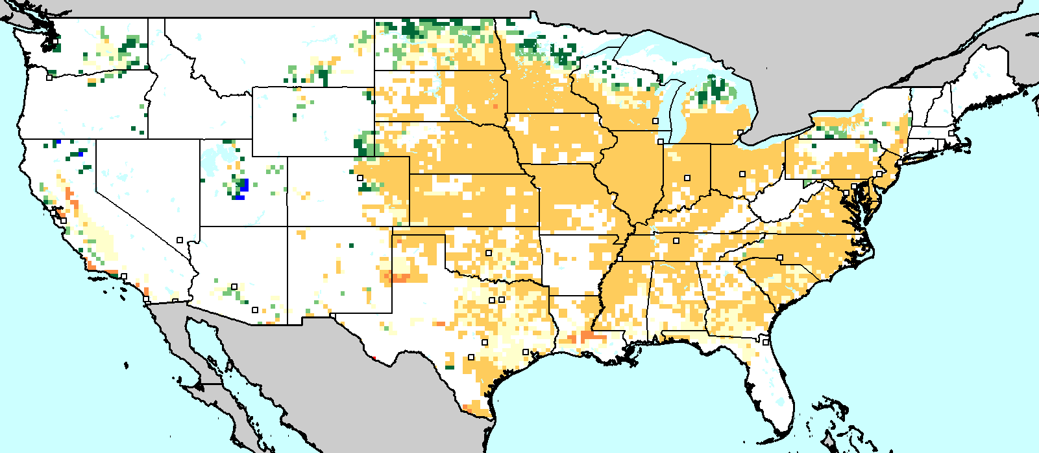
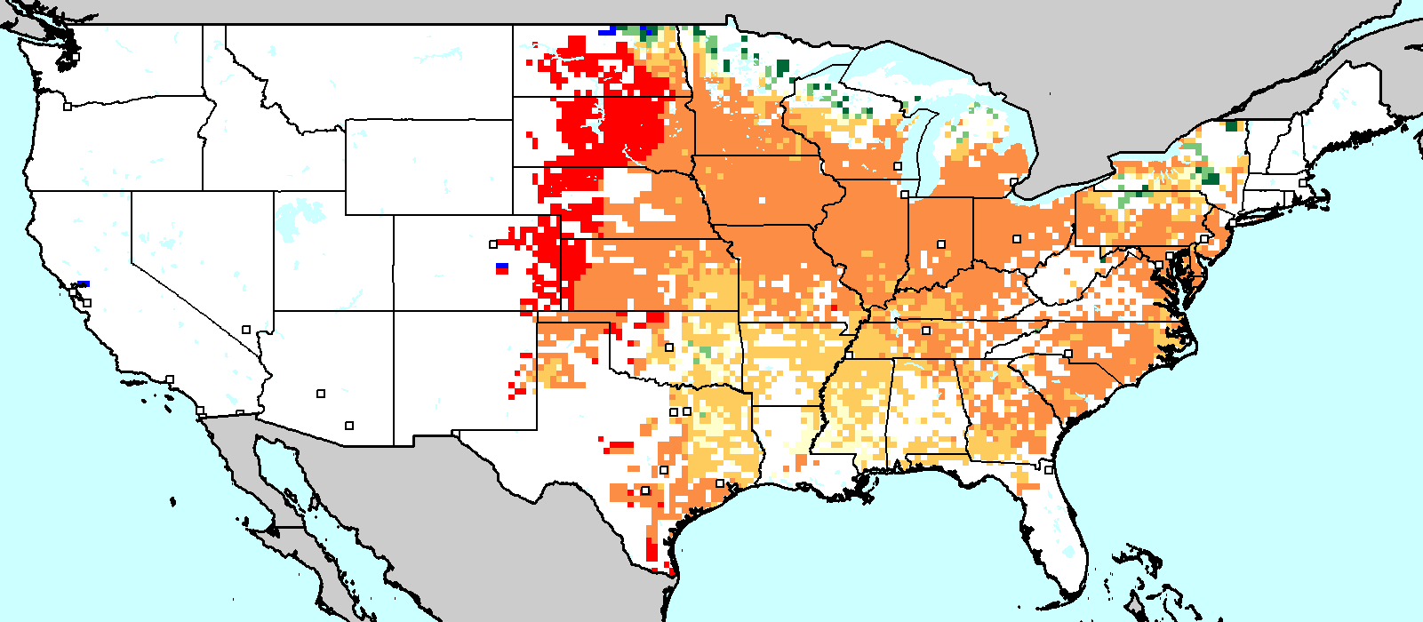
Scenarios for Adaptation Biophysical Scenarios
MAIZE
Irrigated
Rainfed
CSIRO
Irrigated
Rainfed
MIROC
Source: IFPRI calculations based on downscaled climate data and DSSAT model runs

Slide 23
Scenarios for Adaptation Biophysical Scenarios
MAIZE
Irrigated
Rainfed
CSIRO
Irrigated
Rainfed
MIROC
Source: IFPRI calculations based on downscaled climate data and DSSAT model runs

Slide 24
Scenarios for Adaptation Biophysical Scenarios
MAIZE
Irrigated
Rainfed
CSIRO
Irrigated
Rainfed
MIROC
Source: IFPRI calculations based on downscaled climate data and DSSAT model runs

Slide 25
Scenarios for Adaptation Biophysical Scenarios
MAIZE
Irrigated
Rainfed
CSIRO
New irrigation required to avoid crop failure
Irrigated
Rainfed
MIROC
Source: IFPRI calculations based on downscaled climate data and DSSAT model runs

Slide 26
Scenarios for Adaptation Biophysical Scenarios
MAIZE
Irrigated
Rainfed
CSIRO
Irrigated
Rainfed
MIROC
Source: IFPRI calculations based on downscaled climate data and DSSAT model runs

Slide 27
Scenarios for Adaptation Biophysical Scenarios
MAIZE
Irrigated
Rainfed
CSIRO
Irrigation not required for yield increases
Irrigated
Rainfed
MIROC
Source: IFPRI calculations based on downscaled climate data and DSSAT model runs

Slide 28
Scenarios for Adaptation Biophysical Scenarios
MAIZE
Irrigated
Rainfed
CSIRO
Irrigation not required for yield increases
Irrigated
Rainfed
Irrigation required to prevent yield loss
MIROC
Source: IFPRI calculations based on downscaled climate data and DSSAT model runs

Slide 29
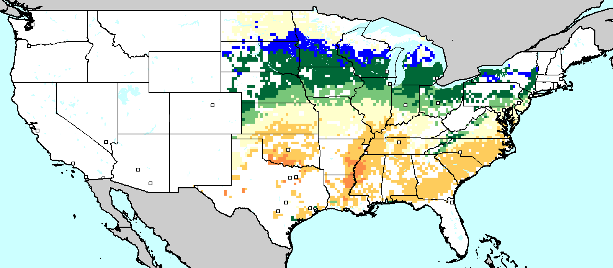
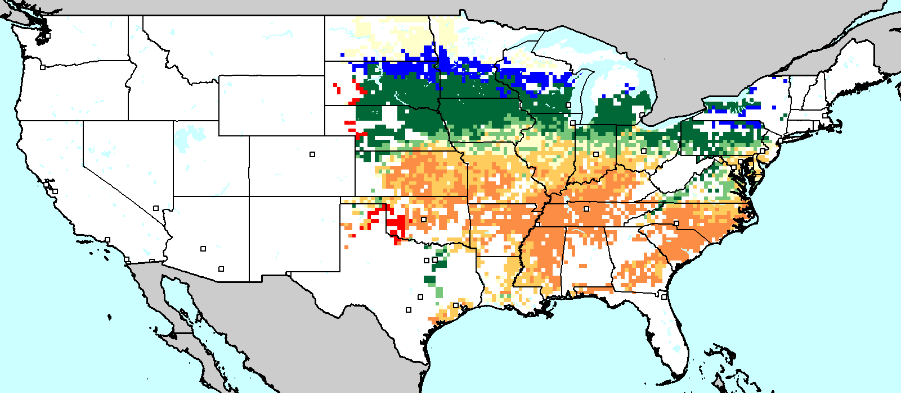
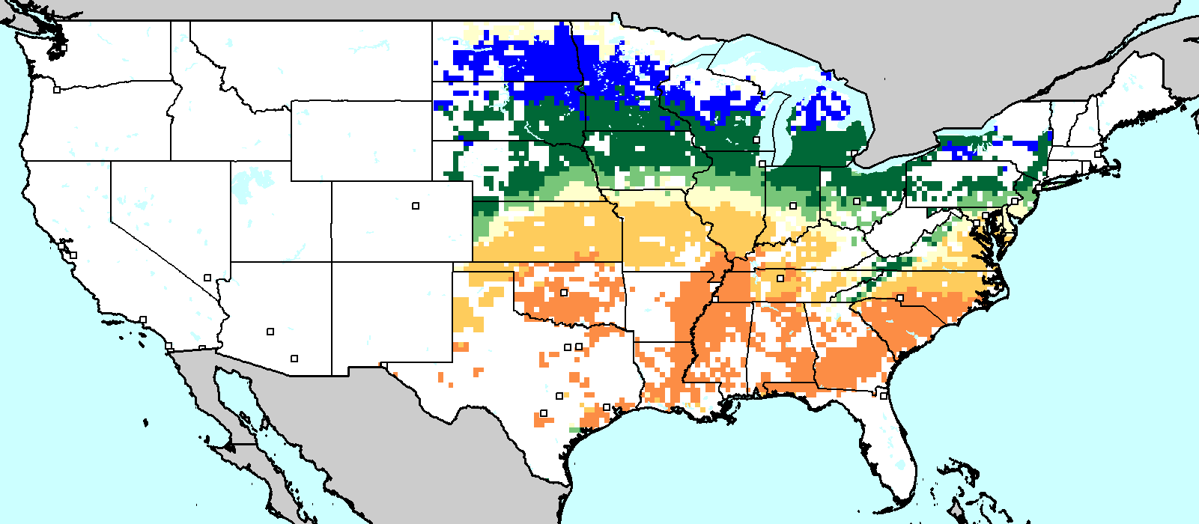
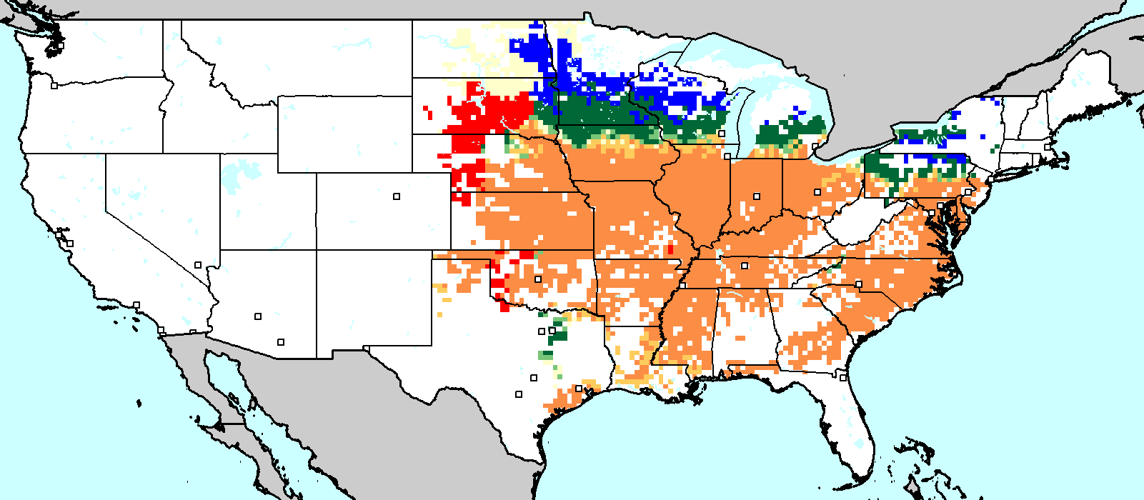
Scenarios for Adaptation Biophysical Scenarios
SOYBEANS
Irrigated
Rainfed
CSIRO
Irrigated
Rainfed
MIROC
Source: IFPRI calculations based on downscaled climate data and DSSAT model runs

Slide 30
Scenarios for Adaptation Biophysical Scenarios
SOYBEANS
Irrigated
Rainfed
CSIRO
Irrigated
Rainfed
MIROC
Source: IFPRI calculations based on downscaled climate data and DSSAT model runs

Slide 31
Scenarios for Adaptation Biophysical Scenarios
SOYBEANS
Irrigated
Rainfed
CSIRO
Irrigation not required for yield increases
Irrigated
Rainfed
MIROC
Source: IFPRI calculations based on downscaled climate data and DSSAT model runs

Slide 32
Scenarios for Adaptation Biophysical Scenarios
SOYBEANS
Irrigated
Rainfed
CSIRO
Irrigation not required for yield increases
Irrigated
Rainfed
MIROC
Source: IFPRI calculations based on downscaled climate data and DSSAT model runs

Slide 33
Scenarios for Adaptation Biophysical Scenarios
SOYBEANS
Irrigated
Rainfed
CSIRO
Irrigation not required for yield increases
Irrigated
Rainfed
Irrigation required
MIROC
Source: IFPRI calculations based on downscaled climate data and DSSAT model runs

Slide 34
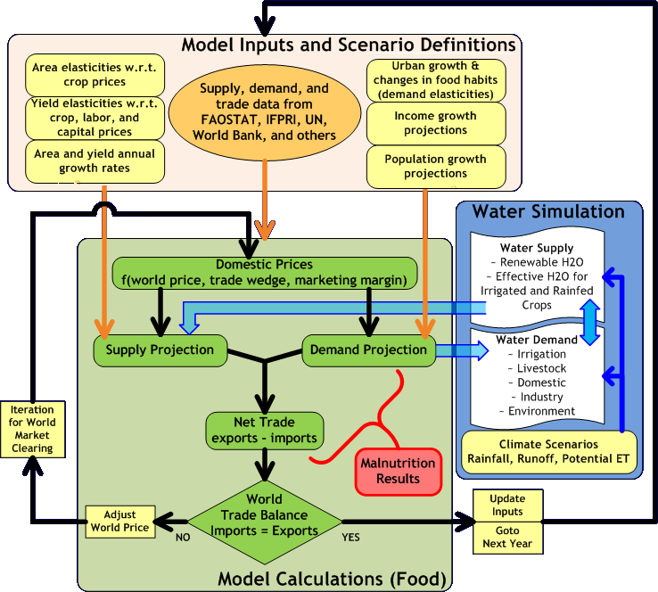
Scenarios for Adaptation IMPACT Model
Three Component Models
* IFPRI’s IMPACT model (Cline 2008), a partial equilibrium agriculture model that emphasizes policy simulations
*Hydrology model an associated water-supply demand model
*DSSAT crop modeling suite (Jones et al. 2003) estimates crop yields in response to climate, soil, and nutrient availability,
Methodology reconciles the limited spatial resolution of macro-level economic with detailed models of biophysical processes at high spatial resolution.
Analysis is done at a spatial resolution of ~ 30 km. Results are aggregated up to the IMPACT model’s 281 food production units (FPUs)defined by political boundaries and major river basins.
Source: Nelson, et al, 2010

Slide 35
Scenarios for Adaptation IMPACT Model
Food Producing Units in IMPACT
Source: Nelson et al. 2010

Slide 36
Scenarios for Adaptation Income and Demographic Scenarios
IFPRI’s IMPACT model drivers used for simulations include: population, GDP, climate scenarios, rainfed and irrigated exogenous productivity and area growth rates (by crop), and irrigation efficiency.
GDP and population choices
Per capita growth rates
Source: Based on analysis conducted for Nelson et al. 2010
Source: World Development
Indicators for 1990–2000 and
authors’ calculations for 2010–2050

Slide 37
Scenarios for Adaptation Income and Demographic Scenarios
IFPRI’s IMPACT model drivers used for simulations include: population, GDP, climate scenarios, rainfed and irrigated exogenous productivity and area growth rates (by crop), and irrigation efficiency.
GDP and population choices
Per capita growth rates
Source: Based on analysis conducted for Nelson et al. 2010
Source: World Development
Indicators for 1990–2000 and
authors’ calculations for 2010–2050

Slide 38
Scenarios for Adaptation Income and Demographic Scenarios
GDP Per Capita Scenarios
Per Capita Income Scenario Outcomes

Slide 39
Scenarios for Adaptation Agricultural Vulnerability Scenarios Outcomes
Maize
Soybeans
Based on IMPACT results from September 2011

Slide 40
Scenarios for Adaptation Agricultural Vulnerability Scenarios Outcomes
Maize
Soybeans
Based on IMPACT results from September 2011

Slide 41
Example of How Iowa Agricultural Producers are Adapting to Climate Change:
Longer growing season: plant earlier, plant longer season hybrids, harvest later
Wetter springs: larger machinery enables planting in smaller weather windows
More summer precipitation: higher planting densities for higher yields
Wetter springs and summers: more subsurface drainage tile is being installed, closer spacing, sloped surface
Fewer extreme heat events: higher planting densities, fewer pollination failures
Higher humidity: more spraying for pathogens favored by moist conditions, more problems with fall crop dry-down, wider bean heads for faster harvest due to shorter harvest period during the daytime
Drier autumns: delay harvest to take advantage of natural dry-down conditions, thereby reducing fuel costs

Slide 42
Agriculture and Greenhouse Gas Mitigation Agricultural emissions history and potential mitigation
Opportunities for mitigation by agriculture:
* Increased adoption of conservation tillage practices
* Optimization of landscape management (perennial dedicated energy crops)
* Development and implementation of new technologies, such as the nitrogen-use efficiency biotech traits
USA GHG Emissions (CO2, CH4, N2O, PFCs, HFCs, SF6) by Sector
Source: Climate Analysis Indicators Tool (CAIT) Version 8.0. (World Resource Institute 2011)

Slide 43
Conclusions
Analysis shows that climate change does not represent a near-term threat to food security to the US.
US crop yields have shown a steady exponential growth over the past 40 years of increasing temperatures
This trend is expected to continue for the next 40 years (through 2050), provided that producers continue to be as successful in adapting to climate change in the next 40 years as they have been in the last 40 years.
This report did not examine climate trends for the latter half of the 21st century

Slide 44
Summary for Policy Makers
Increased investments in agricultural research by both private and public sector are urgently needed.
Adaptation capacity of agricultural producers is closely linked to income. Reduction in farm income will have a compounding negative impact on the ability of producers to make critical adaptations to climate change.
It is in the self-interest of the US for both food security and national security more generally to facilitate agricultural research and profitable farming in all countries in order to enhance global agricultural adaptive capacity and minimize risk from food price spikes
Near-term advances underway in climate modeling (NARCCAP) and crop modeling (AgMIP), particularly at regional scales, will enable refinements to capacity for modeling impacts on agriculture. Revisiting food security issues should be done at regular intervals to take advantage of scientific developments.
Better data, including economic data, on adaptation strategies and outcomes should be accumulated for modeling future challenges and opportunities for adaptive management.

Slide 45
Summary for Policy Makers
New, broad collaborations are urgently needed to (1) determine the current and expected production and distribution gains for staple crops based on best available data and modeling from private and public sources; (2) quantify production gaps and prioritize critical public/private research and collaborations to meet production/distribution needs; and (3) identify key enabling programs, technologies, practices, policies and collaborations to improve the probability for success.
There is a need to increase standardization and transparency in integrated modeling of agricultural systems through harmonization of terms, units and standards, and by supporting the storage and sharing of validated public computer codes and data that can be used for modeling activities.
Improve the individual component models, especially for crop growth;
Develop validated integrated modeling tools for evaluating the economic, environmental, and social tradeoffs intrinsic to agricultural production, including water quality, biodiversity, and other sustainability topics.
Create sustainable private/public partnerships that utilize emerging science and technologies to urgently address gaps that affect crop yields.

